Slide 1

Intro to Supervised Learning
Linear Regression

Slide 2
Intro to supervised learning and Linear Regression – Topics
Machine Learning:
Intro to machine learning, learning from data.
Supervised and Unsupervised learning, , train - test data.
Overfitting and Under fitting
Linear Regression:
Linear relation between two variables, measures of association – correlation and covariance.
A simple fit, best fit line – measure of a regression fit.
Multiple regression
R squared.

Slide 3
Machine Learning
The ability of a computer to do some task without being explicitly programmed.
The ability to do the tasks come from the underlying model which is the result of the learning process.
The model is generated by learning from huge volume of data, huge both in breadth and depth reflecting the real world in which the processes are performed.
What machine learning algorithms do?
Search through the data to look for patterns in form of trends, cycles, associations, etc.
Express these patterns as mathematical structures.

Slide 4
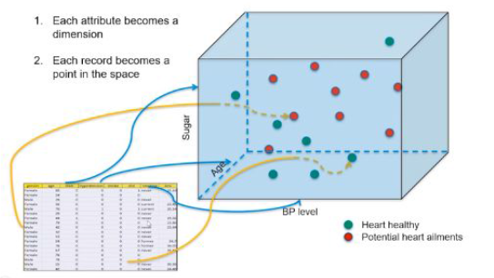
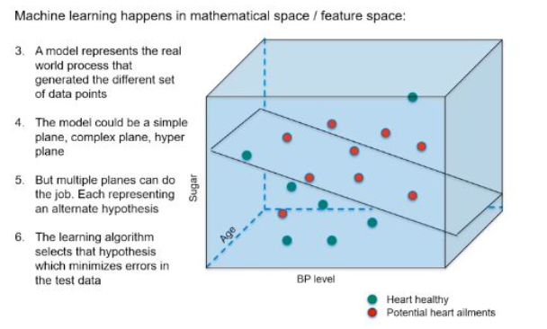
Machine Learning Contd.
A data point in a real world comprises of different attributes which identify it as an entity. Such data points come together to form a data set to be learned from in a mathematical space.

Slide 5
Supervised Machine Learning
Class of machine learning that work on externally supplied instances in form of predictor attributes and associated target values.
The target values are the ‘correct answers’ for the predictor model which can either be a regression model or a classification model (classifying data into classes.)
The model learns from the training data using these ‘correct answers/target variables’ as reference variables.
The model thus generated is used to make predictions about data not seen by the model before.
Ex1 : model to predict the resale value of a car based on its mileage, age, color etc.
Ex2 : model to determine the type of a tumor.
If the model does very well with the training data but fails with test data(unseen data), overfitting is said to have taken place. However, if the data does not capture the features of train data itself, we term it as under fitting.

Slide 6
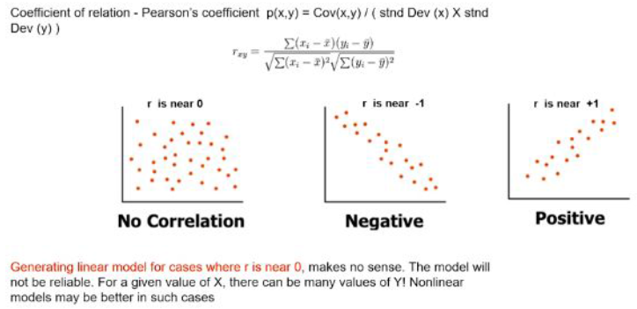
Measures of Association
Covariance
Covariance is a measure of association between two variables.
It represents association in units of the two variables.
Correlation
Correlation is also a measure of association between two variables.
Moreover, it is a dimensionless quantity and thus enables comparison beyond units.
Coefficient of correlation is also known as Pearson’s coefficient

Slide 7
Linear Regression
The term “Regression” generally refers to predicting a target value, which is generally a real number, for a data point based on its attributes.
The term “linear” in linear regression refers to the fact that the method models data with linear combination of the explanatory variables (attributes).
In case of linear regression with a single explanatory variable, the linear combination can be expressed as :
response = intercept + constant*explanatory variable

Slide 8
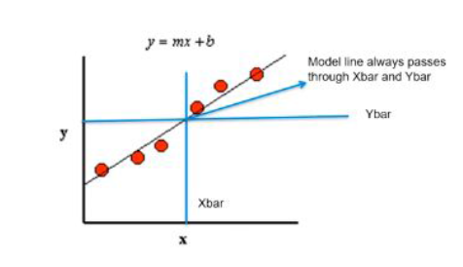
Best fit line
Learning from the data, the model generates a line that fits the data.
This line tries to explain the variance in the data.
Our aim is to find a regression line that best fits the data.
In the diagram below, we see the regression line. The red dots are the data points which constitute our data set.

Slide 9
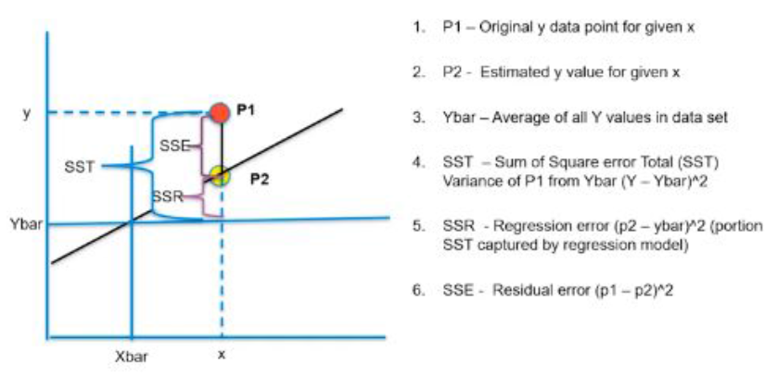
Best Fit Line Contd
R SQUARED VALUE
The r squared is considered a measure of goodness of a fit.
It is the portion of the variance in data that is covered by the model. This is given by -
R Squared = (SST-SSE)/SST
= SSR/SST
The picture shows the different measures of a fit.

Slide 10
Multiple regression
Till now we have seen a simple regression where we have one attribute or independent variable.
However, in the real world, a data point has various important attributes and they need to be catered to while developing a regression model.
Ex: predicting price of a house, we need to consider various attributes related with this house. Such a regression problem is an example of a multiple regression.
This can be represented by :
target = constant1*feature1 + constant2*feature2 + constant3*feature3 + …..+ intercept
The model aims to find the constants and intercept such that this line is the best fit.

Slide 11
Pros and Cons of Linear Regression
Advantages
Simple to implement and easier to interpret the outputs coefficient.
Disadvantages
Assumes a linear relationships between dependent and independent variables.
Outliers can have huge effects on regression.
Linear Regression assume independence between attributes.

Slide 12
Case Study
Problem :
A certain bank wants to predict the credit loss based on the details provided by the customer while applying for loan. These details are Age, Years of Experience, Number of cars, Gender, Marital Status.
The objective is to come up with a regression model which can predict the credit loss based on the above parameters . Here are the details about the data set.

Slide 13
Case Study Contd.
Data Attributes:
Ac_no: The account of customer used as identifier.
Age: Age of the borrower
Years of experience: Working experience
Number of vehicles: Number of cars possessed
Gender: M/F
Losses in thousands: Target variable

Slide 14
Case Study Contd.
Steps to follow:
Import libraries
Get the data
Find top 5 headings from the data
Plot histograms
Find the correlation between variables.
Drop variables which are of no use to the model.
Find the model using coefficients

Slide 15


AIML @WORK
PGPAIML @ Great Learning
Enabling Learners to Apply the AI/ML Concepts at Work
Apply AIML at your workplace to gain some instant benefits:
Get noticed by your management with your outstanding analysis backed by data science.
Create an impact in your organization by taking up small projects/initiatives to solve critical issues using data science.
Network with members from the data science vertical of your organization and seek opportunities to contribute in small projects.
Share your success stories with us and the world to position yourself as a subject matter expert in data science.
AIML Operations | AIMLAW
@Great Learning Proprietary Content. All rights reserved. Unauthorized use or distribution prohibited

Slide 16

Questions if any…

